Slide 1
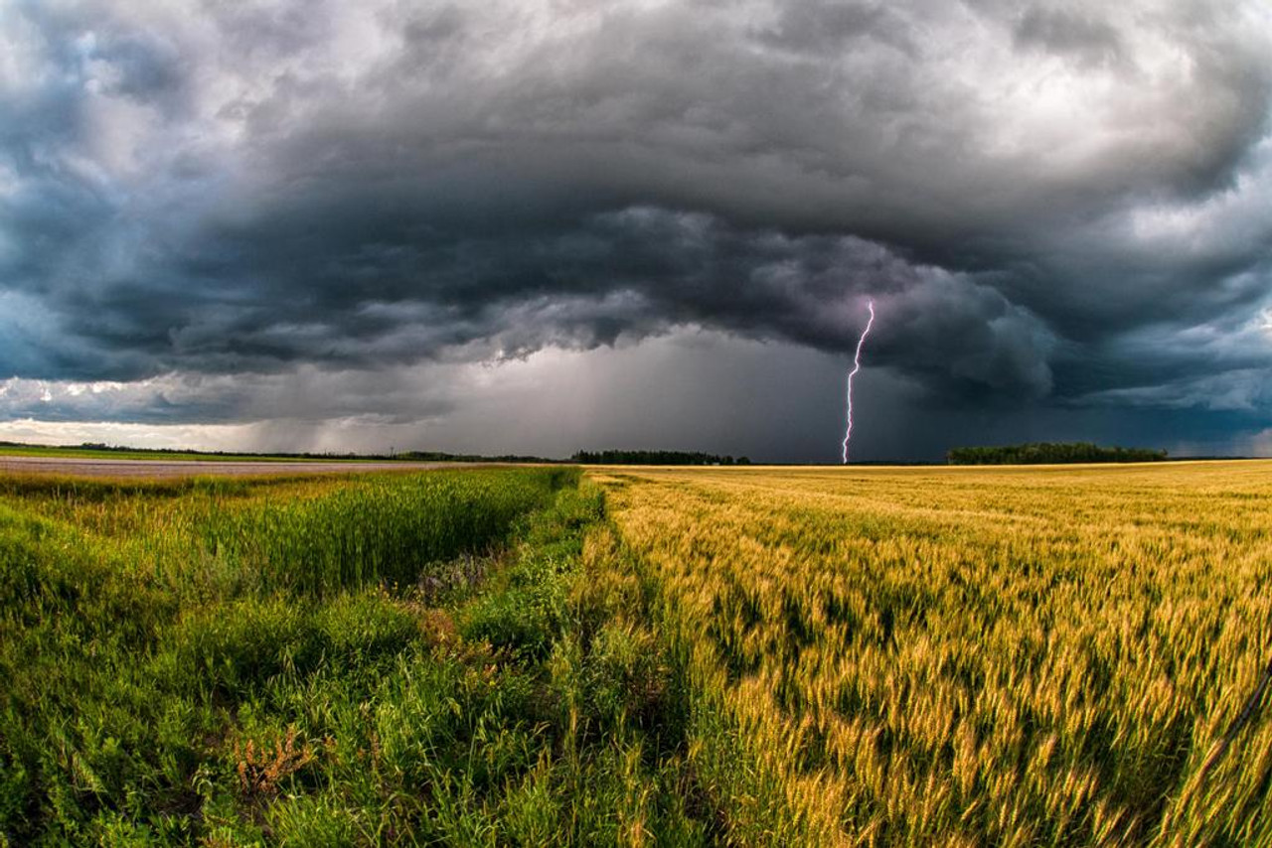




Exploring the Power of Weather Data
Contributors:
Discovering the Power of Weather Data in Agricultural Predictions
Mason Galusha
Marquez Ward
Jim Carson
Graham Adams

Slide 2
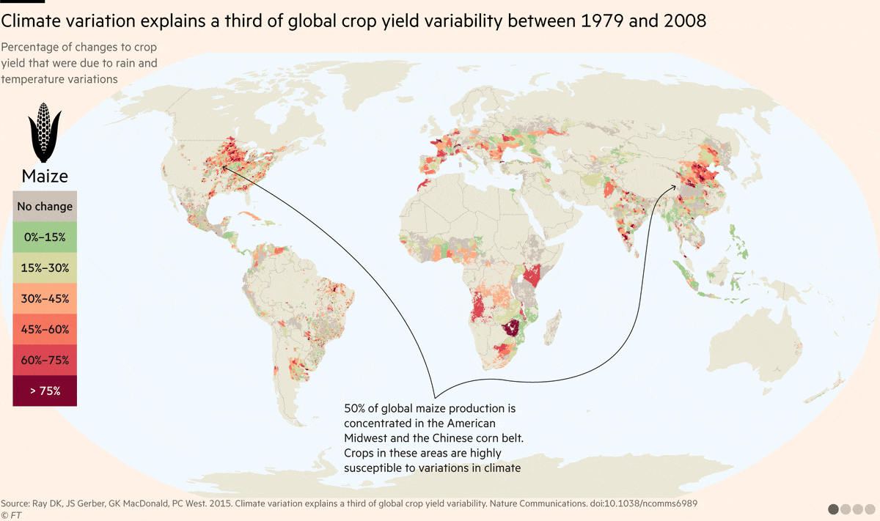
Introduction
Leveraging weather data to predict crop yields for specific regions
Focused on U.S. state-level data for more manageable and accurate predictions
Aimed to provide actionable insights for farmers using machine learning models
Faced challenges with crop data, but explored new possibilities for improvement
Notes:
Initially, we considered using global data, but due to time constraints, we narrowed our focus to U.S. state-level data. This decision allowed us to manage the scope more effectively, ensuring that the data was clean and consistent while still providing enough regional variety for robust modeling. By concentrating on the U.S., we streamlined the data collection process and maintained a high level of accuracy in our predictions.
Our primary aim was to offer actionable insights. We hoped to guide decision-making on which crops to plant and how to manage them based on regional weather patterns. Through this data-driven approach, we sought to enhance crop management practices, leading to better yields and reduced risks for farmers. Along the way, we faced challenges with the complexity of crop data—it’s highly variable and not the only factor influencing yields. However, these challenges opened up new possibilities for improvement, such as incorporating additional data types or exploring alternative predictive models.

Slide 3
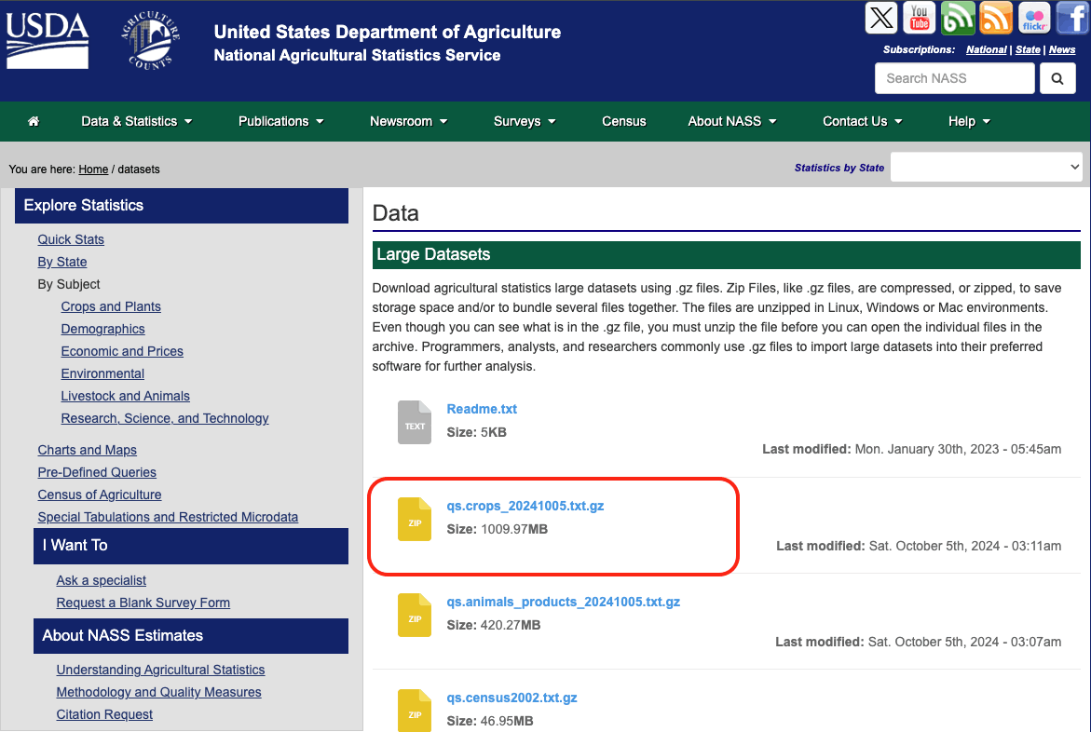
Crop Data Collection and Generalization
Downloaded crop data from the USDA National Agricultural Statistics Service (NASS)
Dealt with a large, messy dataset of 22 million rows and 39 columns
Generalized location data by converting specific areas to state-level entries
Converted zip codes to corresponding states using external datasets

Slide 4
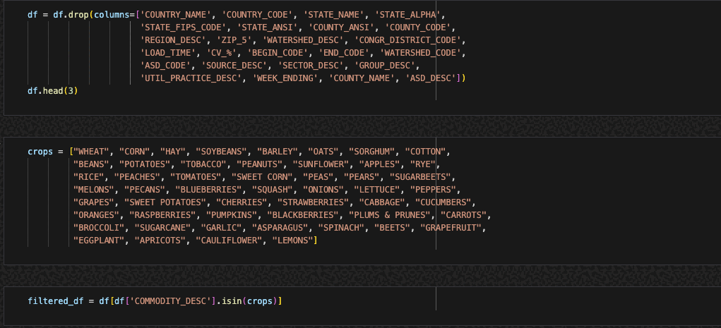
Crop Data Cleaning and Normalization
Faced challenges with unit types—over 200 different units for crop data
Normalized the value column by crop and unit type for consistent comparison
Removed irrelevant columns and filtered out low-data units
Final dataset after cleaning: 12 million rows and 5 columns
Notes:
One significant challenge we encountered was dealing with over 200 different unit types in the crop data. These units varied widely—from ‘tons per acre’ and ‘bushels per acre’ to ‘operations,’ which referred to the number of activities happening on a farm. Generalizing these diverse units was a major hurdle, as not all were useful for predicting yield.
To address this, we grouped the data by crop and unit type and then normalized the values. We employed a percentile-based method to scale all values between 0 and 100, where 0 represented no yield and 100 represented the best possible yield for that crop. This standardization allowed us to compare data consistently, despite the vast differences in the original units.
After normalization, we removed irrelevant columns that didn’t directly relate to yield—such as ‘operations,’ which didn’t provide meaningful insights into crop growth. We also filtered out any units with fewer than 500 data points, as they lacked sufficient information for accurate predictions. By the end of the cleaning process, we had reduced the dataset from 22 million rows and 39 columns to about 12 million rows and 5 columns. This was a significant step in making the data manageable for our models while retaining enough detail for accurate predictions.

Slide 5
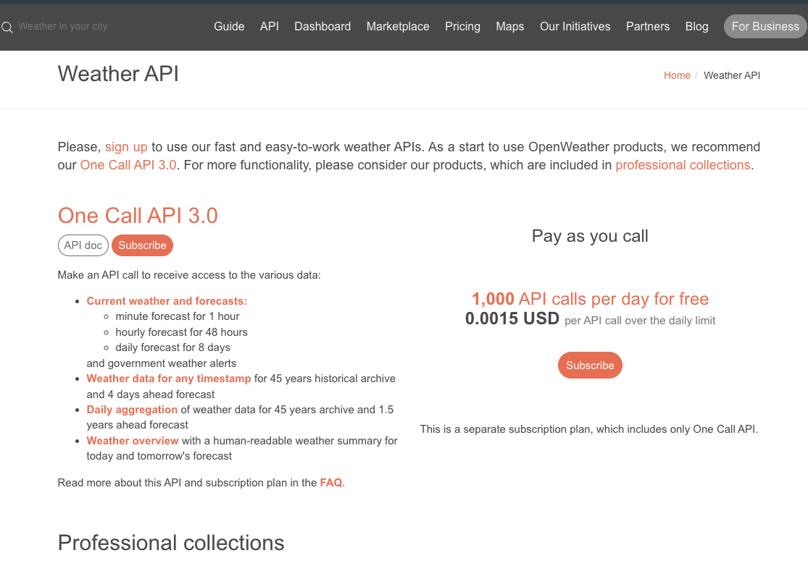
Weather Data Collection
Used OpenWeather API to collect historical weather data (1980-present)
Initial plan: 4-5 coordinates per state, resulting in 4 million data points
Refined plan: 52 total coordinates, one per state (except CA, TX)
Selected 24 days per year to balance accuracy and API limits
Managed budget to keep API calls under 60,000 for <$100
Developed code to automate data collection and handle errors efficiently
API call process took ~7 hours to complete for all states
Notes:
To gather the necessary weather data, we utilized the OpenWeather API to collect historical weather records from 1980 to the present. This data was essential for building the seasonal climate profiles that would drive our predictions.
Initially, we planned to collect data from 4 to 5 coordinates per state, which would have resulted in approximately 4 million data points. However, this proved unfeasible due to the sheer volume of data, high costs, and lengthy API call times. To overcome this, we refined our plan to use 52 total coordinates—one per state, except for California and Texas, which each had two due to their size and climate diversity. This adjustment provided a more manageable dataset while still capturing sufficient variability.
Instead of collecting daily data, we selected 24 specific days per year to capture seasonal trends, balancing accuracy with API limits. By reducing the number of coordinates and days, we kept our API calls under 60,000, managing to keep costs below $100. I developed code to automate the data collection process, looping through each coordinate, year, and day, and included error handling to efficiently manage any issues. The entire API call process took about seven hours to complete, and despite the scale, we were able to gather the necessary data with minimal issues.

Slide 6
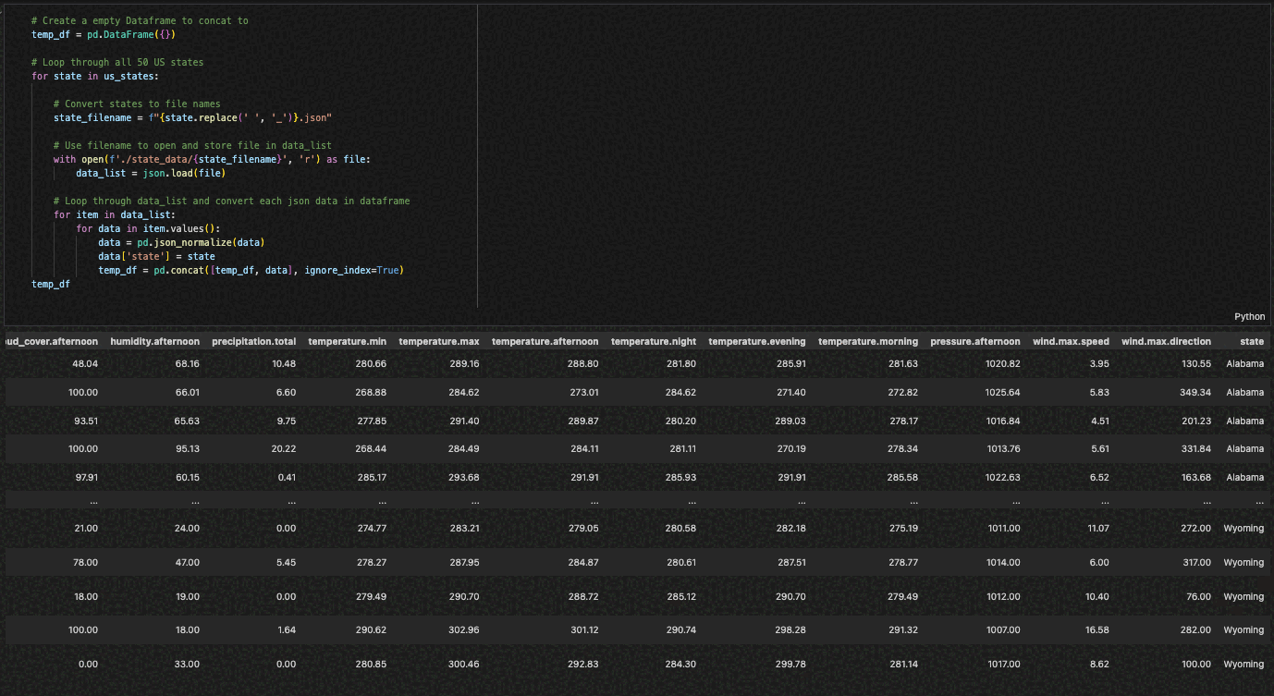
Weather Data Preparation
Stored weather data by state for efficient processing
Collected over 55,000 data points from 52 locations
Converted daily data into seasonal averages (Q1, Q2, Q3, Q4)
Added a ‘quarter’ column based on date to categorize the data
Grouped data by state, year, and quarter, then averaged values
Pivoted data to create one row per year with seasonal columns
Prepared clean, quarterly weather data ready for merging
Notes:
To efficiently manage the collected weather data, we stored each state’s data in separate files. This approach distributed the processing load and allowed us to easily access or modify individual states without affecting the entire dataset. In total, we collected over 55,000 data points from 52 locations, including two for California and Texas, spanning nearly 44 years.
Recognizing that daily data was too granular for our purposes, we converted it into seasonal averages representing the four quarters of each year—Q1 through Q4. To achieve this, we added a ‘quarter’ column based on the date, categorizing each data point into one of the four seasons. We then grouped the data by state, year, and quarter, calculating the average values for each weather variable. This step allowed us to capture seasonal trends without dealing with daily fluctuations.
After grouping, we pivoted the dataset so that each state-year combination had one row, with separate columns for each quarter. This reduced the overall dataset size and made it much easier to work with in our models. At this point, the weather data was fully prepared and structured, with clean quarterly averages ready to be merged with the crop yield data, moving us closer to the model training phase.

Slide 7
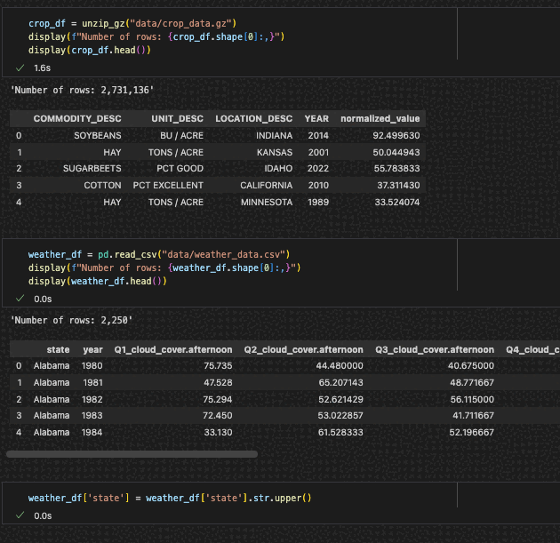
Merging Weather and Crop Data
Merged weather and crop data based on location and year
Used state names as the common key for merging datasets
Kept entire crop dataset, filtered weather data for missing entries
Final dataset combined weather and crop yield information
Dataset ready for model training with both weather and crop features
Notes:
With our weather data cleaned and structured, we proceeded to merge it with the crop yield data. We used state names and years as the common keys for merging, ensuring that the weather data aligned correctly with the corresponding crop data. We decided to keep the entire crop dataset intact, as it contained valuable historical yield information, and filtered out any incomplete or missing weather data to maintain the accuracy of the merged dataset.
The result was a comprehensive dataset combining both weather and crop yield information for every U.S. state over multiple years. This dataset included all relevant weather and crop features, making it ready for the next step: training our machine learning models to predict crop yields based on weather patterns.

Slide 8
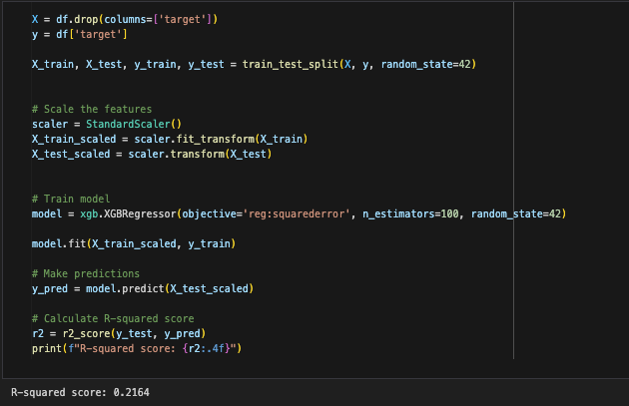
Initial Model Training
(Crop Yield Prediction)
Initial Model: Linear Regression with 19% accuracy
Removed irrelevant data (money, operations), but accuracy dropped to 16%
XGBoost increased accuracy to about 22%
Lack of sufficient data led to limited prediction accuracy
Notes:
We began our modeling with a linear regression approach to predict crop yields based solely on weather data. This initial model achieved an accuracy of 19%, indicating that while weather data plays a role, it was insufficient on its own for accurate predictions. We then attempted to improve the model by removing data unrelated to yield, such as financial units and operations. However, this actually caused the accuracy to drop to 16%, suggesting that these variables, while seemingly unrelated, were contributing to the model’s predictions.
Exploring different models, we found that XGBoost performed the best, increasing our accuracy to 22%. Despite this improvement, it became clear that weather data alone could not adequately explain crop yields. The limited prediction accuracy was due to a lack of comprehensive data—crop yields depend on many factors beyond weather, such as soil quality, economic conditions, and resource allocation, which were not included in our dataset.

Slide 9

Limitations and Decision to Pivot
Weather data alone is not sufficient for accurate predictions
Additional data like soil quality, economic resources, and pest data could improve accuracy
County-level data would likely provide a more granular and accurate model
Collecting more data wasn’t feasible within the two-week project timeline
Notes:
The main challenge we faced was that weather data alone isn’t sufficient for accurate crop yield predictions. While it’s an important factor, other variables play significant roles in agricultural outcomes. To improve the model’s accuracy, we would need to incorporate additional data such as soil quality, economic resources, and pest or animal activity—all of which can significantly impact crop yields.
Collecting data at the county level would likely provide a more granular and accurate model, especially for factors like soil and economics. However, obtaining weather data at this level of detail would be expensive and time-consuming. Given our two-week project timeline, it wasn’t feasible to collect and process this additional data. Therefore, we decided to pivot and explore a different application of the weather data we had collected.

Slide 10
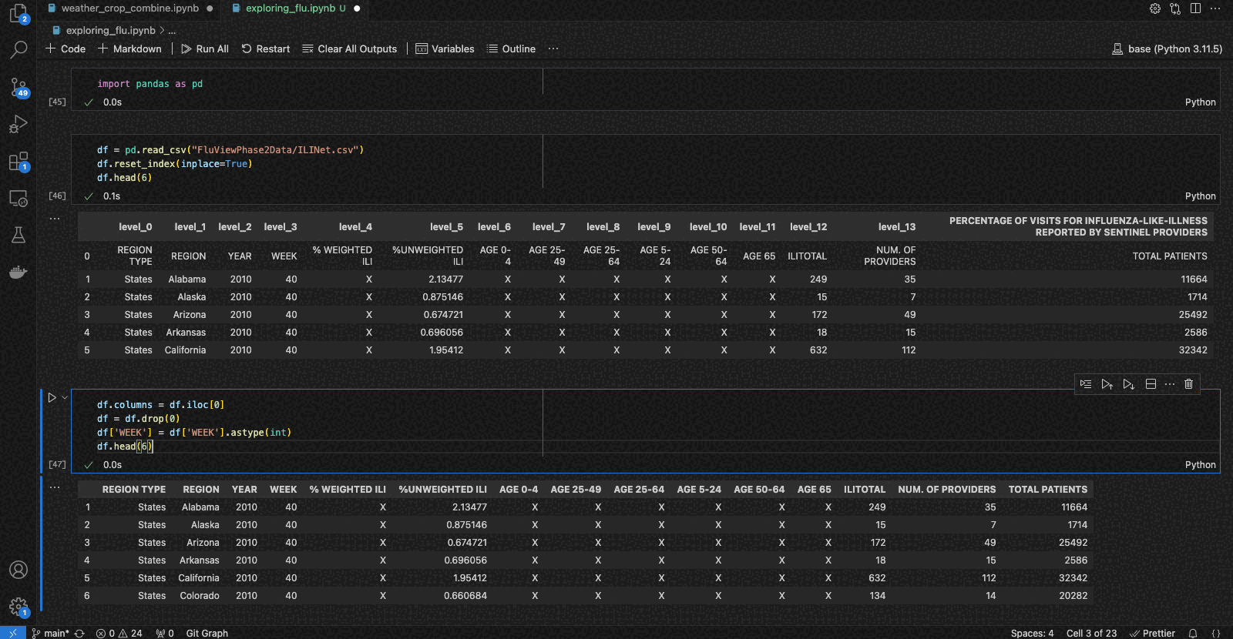
Pivot to Flu Prediction
Explored weather’s impact on flu prediction
Collected flu data from the Agency for Toxic Substances and Disease Registry (2010-2020)
Averaged flu data by season using week-to-quarter conversion
Merged flu data with weather data by state and season
Notes:
Recognizing the limitations of using weather data to predict crop yields, we shifted our focus to exploring how weather might impact flu outbreaks. We hypothesized that weather patterns, such as temperature and humidity, could influence the spread of influenza.
We collected flu data from the Agency for Toxic Substances and Disease Registry, covering the years 2010 to 2020. This data tracked flu cases by state and would serve as the target variable in our new model. The flu data was organized by week, but to align with our weather dataset, we converted it into quarterly data by grouping every 13 weeks into one of four seasons.
After processing both datasets, we merged the flu data with our seasonal weather data using state and season as the keys, preparing the dataset for model training. This new focus allowed us to explore the predictive power of weather data in a different context.

Slide 11
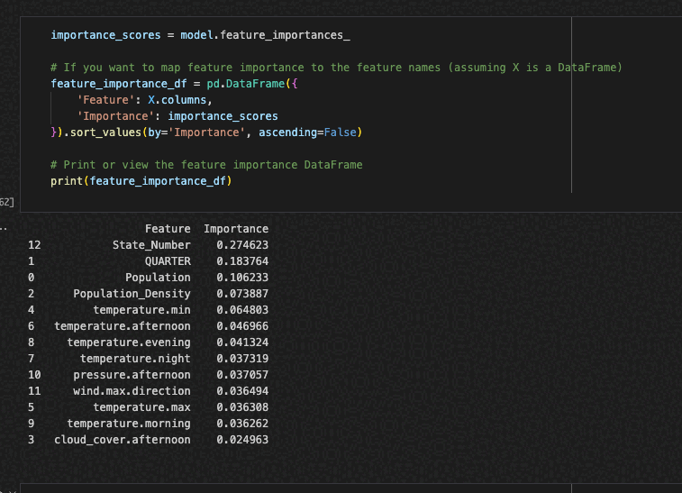
Flu Model Training and Results
Initial model had 25% accuracy based on weather data alone
Added population and state as features, improving accuracy
Calculated population density from state size and population data
XGBoost model reached 60% accuracy after feature engineering
Additional data like county-level flu reports and public events could improve predictions
Notes:
Using only weather data to predict flu cases, our initial model achieved an accuracy of 25%, a significant improvement over our crop predictions. To enhance the model further, we added additional features. We included population data and state identifiers, hypothesizing that population size and state-specific factors could influence flu outbreaks. This addition improved the model’s accuracy.
We then calculated population density for each state by combining population and state size data, recognizing that more densely populated areas might experience higher transmission rates. With these new features, our XGBoost model reached an accuracy of 60%—a substantial improvement given the limited data. This demonstrated that weather, combined with population-related factors, can be a strong predictor for flu cases.
We believe that adding more granular data, such as county-level flu reports, economic conditions, or public event data, could further enhance the model’s accuracy. Despite the limitations, this pivot showed the versatility and potential of the weather data we had collected.

Slide 12
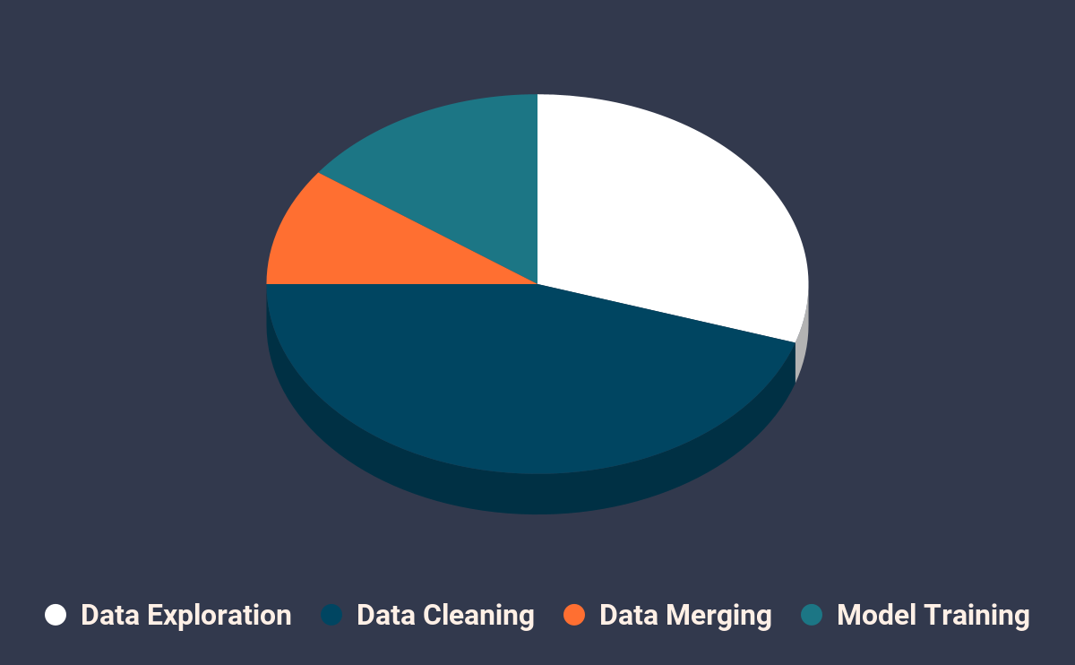
Lessons Learned and Importance of Data Quality
Focused 80-90% of the project on data collection and cleaning
Realistic experience: combining multiple datasets for new insights
Data quality is more important than model optimization
Connecting unrelated datasets taught valuable lessons (e.g., zip codes, population density)
Data-driven insights pave the way for future predictions
Notes:
Throughout this project, we spent the majority of our time—approximately 80 to 90%—on data collection and cleaning. This experience underscored that while model optimization is important, the real challenge and value lie in gathering and preparing high-quality data. Combining multiple, messy, and unrelated datasets to create new insights provided a realistic experience of the complexities involved in data science projects.
We learned that data quality is more crucial than model optimization—you can’t properly optimize a model if your data is inaccurate or inconsistent. Connecting unrelated datasets taught us valuable skills, such as using zip codes to clean location data or combining state sizes with population data to create new features like population density. These experiences will be essential for future projects.
Focusing on data collection and cleaning not only improved our models but also opened the door for many other predictive possibilities, like forecasting wildfires, energy consumption, or natural disasters based on weather data. The insights gained from this project highlight the foundational importance of data in driving meaningful results.

Slide 13
Conclusion and Future Directions
Data is key: We prioritized cleaning over model optimization
Weather data alone can predict certain things, but not all
Future goals: Explore the power of weather data in predicting wildfires, energy use, air quality, and more
Excited to continue building and expanding on this project
Crop Prediction
Weather Data
Soil Data
Economics
Crop Management
Notes:
In conclusion, the key takeaway from this project is that data is fundamental—we prioritized cleaning and preparing the data over model optimization because, without a solid data foundation, no amount of tweaking will yield accurate results. We found that while weather data can be incredibly powerful, it’s only one part of the puzzle. It worked well in predicting flu cases but wasn’t sufficient to predict crop yields on its own, highlighting the importance of context when applying data.
Looking ahead, I’m excited to explore how weather data can be used to predict other significant outcomes like wildfires, energy consumption, air quality, and even pest outbreaks. There are numerous possibilities for making data-driven predictions using weather and related datasets. This project has only scratched the surface of what’s possible, and I’m eager to continue building and expanding on this work to make more accurate predictions across various fields.

Slide 14
Q&A

